Slide 1
Audit Process Automation and Process Redesign: A Case Study
Abigail Zhang
Dr. Chanta Thomas
Continuous Audit & Reporting Lab
Rutgers Business School
47th WCARS
Newark, USA
Nov 9th
Notes:
I am Abby, currently a third-year phd student at Rutgers. It’s my great honor to present our research: which is coauthored with Professor Chanta Thoma from Rutgers.

Slide 2
Outline
Introduction
Case Background
The Original Audit Process
Audit Process Automation and Process Redesign
The RPA Prototype
Evaluation Measures
Limitations and Future Research
Conclusions

Slide 3
Introduction
“Although we did not observe the use of emerging technologies on audits inspected in 2018 — such as artificial intelligence and robotic process automation— we observed that audit firms are actively considering these technologies when developing their future software audit tools.” (Staff Preview of 2018 Inspection Observations, PCAOB).
This is becoming more of a focus by regulatory agencies like the PCAOB and AICPA.
Call for research in understanding how these technologies will affect audit procedures and impact audit quality.
Notes:
First, about the motivation of this research. The PCAOB mentioned in the 2018 inspection observation reports that…
And they call for research in …
To address this reseach need

Slide 4
Introduction
This study focuses on Robotic Process Automation (RPA) :
the process of a pilot development of RPA for a specific type of audit
how RPA can be integrated into the current audit methodology
how audit efficiency and effectiveness can be affected
Notes:
This research focuses on robotic process automation. And in particular, we partnered with a CPA firm in the US and studied the process of RPA development for a specific type of audit and how RPA can be integrated into the current audit methodology, and how the audit efficiency and effectiveness can be affected.

Slide 5
Introduction
Software 1
Software 5
Software 2
Robotic Process Automation (RPA)
Software 4
Software 3
Structured data
Rule-based processes
A single correct outcome
(IEEE, 2017; Lacity and Willcocks, 2017)
Notes:
Robotic Process Automation (RPA) is a preconfigured software instance that can operate on one or more unrelated software systems to automate tasks that have structured data, rule-based processes, and a single correct outcome (IEEE, 2017; Lacity and Willcocks, 2017).

Slide 6
Case Background
Single Audits are audits of non-federal entities that expend $750,000 or more of Federal funds in one year.
A list of candidate tasks for automation in the audit planning phase.
Observed 5 real audit engagements and documented the details of the steps.
Notes:
This small-size CPA firm in the United States came to the authors looking for guidance to automate and redesign some tasks in the Single Audits.
Single Audits are audits of non-federal entities (e.g., states, local governments, universities, and not-for-profit entities) that expend $750,000 or more of Federal funds in one year.
The firm first provided us with a list of candidate tasks for automation in the audit planning phase.
To have a better idea of how the auditors actually conduct these tasks, we visited the CPA firm and observed 5 real audit engagements.
Through observations and discussions with the auditors and managers, we documented the details of the steps in the audit planning of Single Audits.

Slide 7
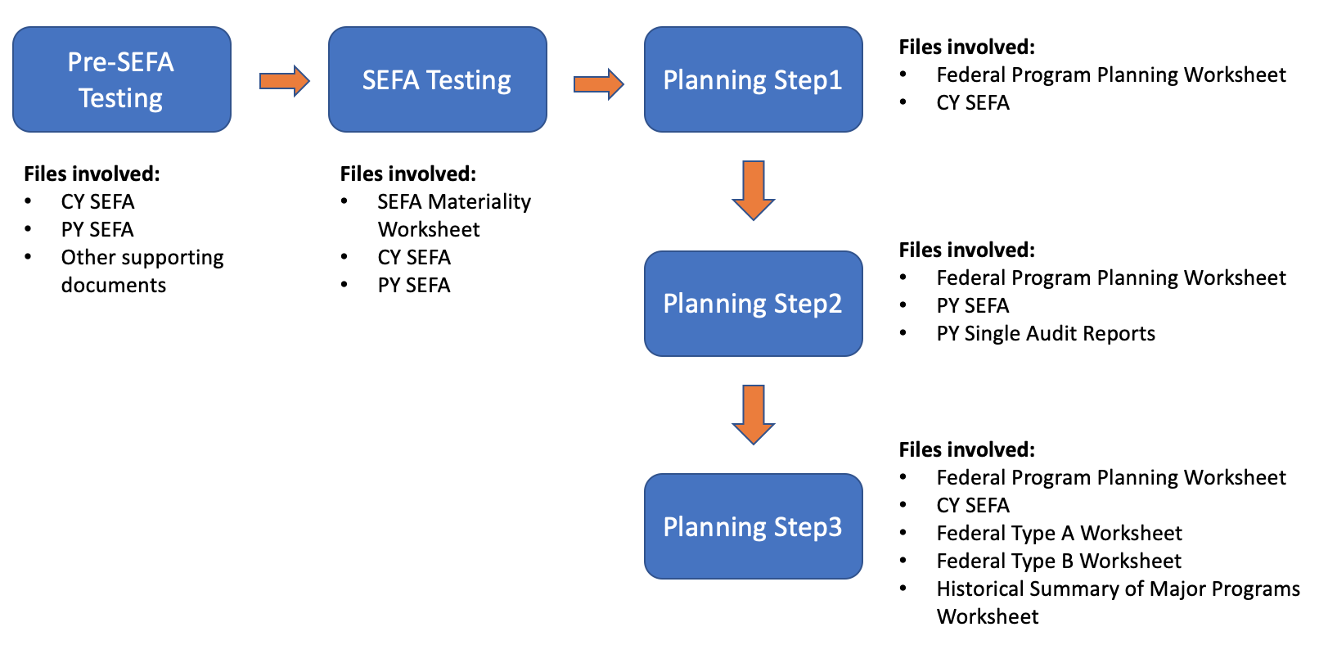
The Original Audit Planning Process
Schedule of Expenditures of Federal Awards (SEFA) (Excel document)
CaseWare document
Validate the integrity of the data by verifying the program title, name of the Federal grantor agency, CFDA number, and program cluster.
Decide SEFA-wide materiality
Notes:
Auditors first obtain a document called Schedule of Expenditures of Federal Awards (SEFA) from the client, which is an excel document that contains all the federal programs and their expenditures.
Then the auditor need to validate the integrity of the data on SEFA.
The next step is to decide the materiality for the total federal fund expenditure
The above procedures are performed on excel with several supporting documents.
Then, the auditors use a planning worksheet, which is a CaseWare document, to conduct other detailed audit planning procedures.
In the Pre-SEFA testing, auditors use CY and PY SEFA and other supporting documents to ensure…
In the SETA testing stage, auditors decide the SEFA-wide materiality using CY and PY SEFA and the SEFA materiality worksheet
Then auditors use a CaseWare document called Federal Program Planning Worksheet and other supporting documents to conduct detailed planning steps.

Slide 8
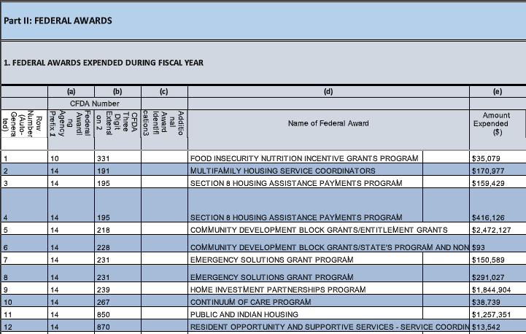
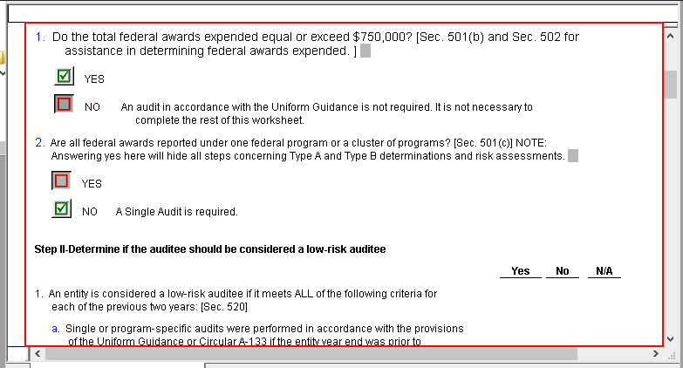
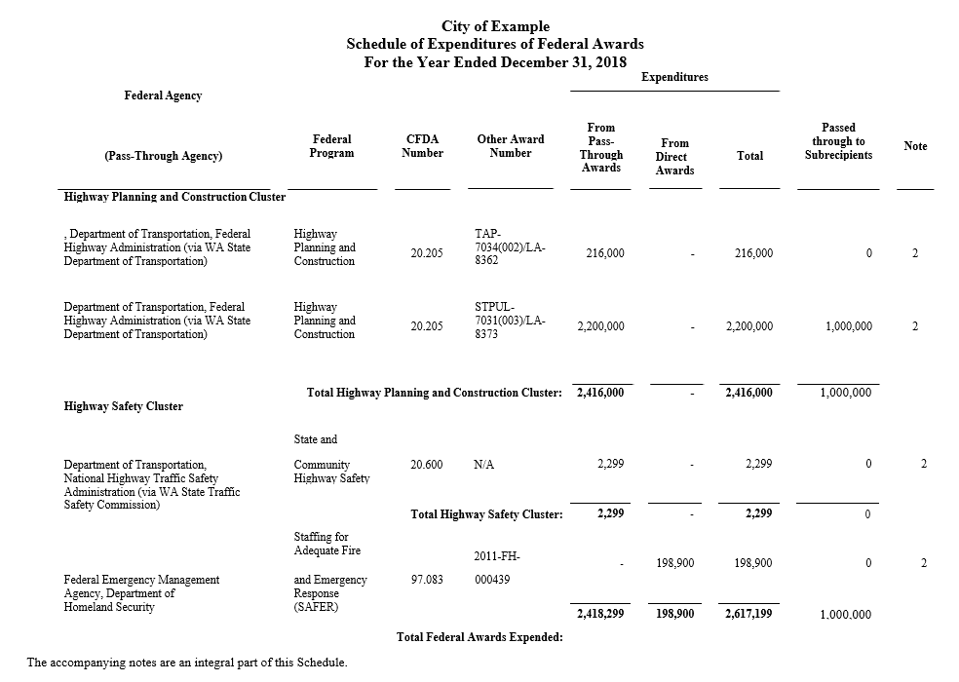
The Original Audit Planning Process
Notes:
At the end of the Single Audit, the audited information will be documented in a Data Collection Form and be uploaded to the Federal Audit Clearinghouse (FAC) website. This file has a standardized and structured format.

Slide 9
Observations of the Original Audit Process
Intensive rule-based manual work
Multiple-file interactions
Time-consuming procedures
Error-prone procedures
Non-standardised annotations
There is a need for process automation and redesign
Good candidates for RPA
Notes:
Through observations, we noticed that the original audit planning processes have intensive manual works that are rule-based, involve multiple-file interactions (some auditors told us they need to use three screens and have several files open to complete certain tasks), are time-consuming and error-prone, and have non-standardised annotations. These all call for audit process automation and redesign. And the rule-based audit tasks are good candidates for RPA.
Due to the application scope of RPA, we need to identify tasks that are highly repetitive, rule-based, and have structured data.

Slide 10
Audit Process Automation and Process Redesign
Identified rule-based and repetitive tasks
Steps | Rule-based tasks
Pre-SEFA Testing | Compare program information of CY SEFA with that of PY SEFA. Group programs that are in the same cluster and calculate the total expenditure for that cluster.
SEFA Testing | Calculate the percentage change of the total expenditure from CY SEFA to PY SEFA.
Planning Step 1 | If the total expenditure per SEFA is above $750,000, then choose “yes” for the first question. If the answer to the previous question is “Yes”, then choose “No” directly for the second question.
Notes:
In audit process automation, we first identified rule-based and repetitive tasks in each step.
In Pre-SEFA testing, the rule-based tasks are:
In SEFA-Testing, calculate…

Slide 11
Audit Process Automation and Process Redesign
Identified rule-based and repetitive tasks
Steps | Rule-based tasks
Planning Step 3 | Input the amount of the total expenditure from the CY SEFA. Choose the range of amount to which the total expenditure belongs. Identify Type A and Type B programs. Count the number of Type A programs and low-risk Type A programs. Count the number of Type B programs and low-risk Type B programs. Calculate the sum of expenditures for all major programs and compare it with the corresponding portion of the total expenditure from CY SEFA.

Slide 12
Audit Process Automation and Process Redesign
Redesigned audit working papers
Standardized the unaudited SEFA file
Standardized other Excel format audit working papers
Reorganized the sequence of some audit tasks
Notes:
However, it’s not enough to just identifying the suitable tasks, to achieve automation, some process redesign should be considered. In particular, we standardized… and

Slide 13
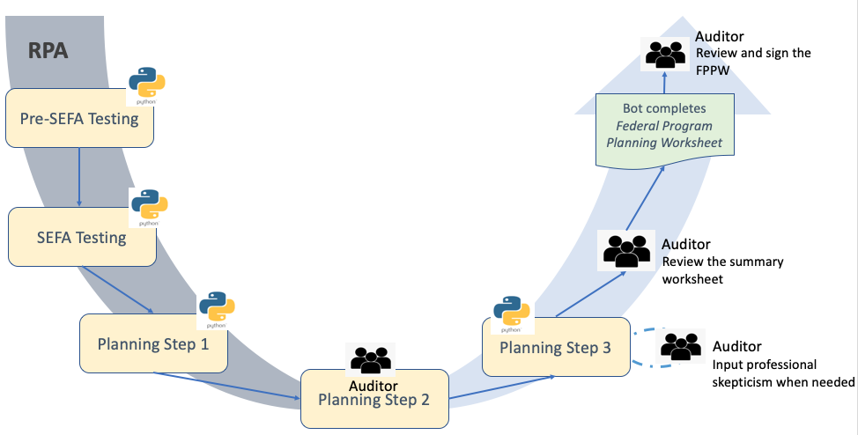
The RPA Prototype
End-to-end process automation for audit planning
Notes:
This is our RPA prototype.
We use the RPA software UiPath to orchestrate and streamline the audit tasks in the audit planning.
In particular, for rule-based tasks that we identified, UiPath will execute Python codes to automate them. We used Python codes because these rule-based tasks require sophisticated data analysis and manipulation and Python works very well in this aspect.
For tasks that require auditor’s judgements, UiPath will interact with auditors using chatboxes and obtain their inputs.
At the end of the procedure, UiPath will fill out the CaseWare planning worksheet based on the results of all the procedures.
The final results are reviewed by the auditors.
This achieves an end to end process automaton for audit planning
The reason for choosing Python: suitable for sophisticated data analysis

Slide 14
Evaluation
Efficiency improvement
Originally, auditors generally spend around 3 hours performing the mundane, repetitive, and rule-based tasks in the audit planning procedure.
The RPA bot can finish the same task within 5 minutes.
Effectiveness improvement
Improved accuracy
Systemized rule-based audit tasks
Standardized some audit working papers
Auditors can spend more time on tasks that require professional judgements.
Notes:
To assess the impact on audit quality, we focuses on efficiency and effectiveness.
For effectiveness, we argue that it can be improved because of the …
We also obtained some measures for the efficiency and effectiveness improvement.
And the facts that

Slide 15
Limitations and Future Research
Limitations:
Hard to obtain efficiency and effectiveness improvement measures from real audit engagements
External auditors are still conservative in adopting emerging technologies
The CPA firm lacks RPA talents to expand the RPA prototype
Future Research
Challenges in adopting RPA in external audit
Potential risks of RPA adoption in external audit
The deployment model of RPA
Decentralized, centralized, or hybrid?
The cost and benefit analysis of using RPA in external audit
Notes:
However, our research does have limitations, especially for the audit quality measures, because it’s hard to …the reason is that… This limitation could be addressed in the future research. Besides, future research can also look at …

Slide 16
Conclusions
RPA has the potential to automate the mundane tasks in external audit
This case study focused on the process of RPA development for Single Audits and its impact on audit quality.
The initial evaluation measures show that the automated and redesigned audit procedure can enhance efficiency and effectiveness.

Slide 17
Thank you!
Please contact me at:
abigail.zhang@rutgers.edu

